Slide 1








Your Entire Sales Team, Powered by AI
Challenge Domain : FinTech ( Scenario 3 + 4 )
Presented by : Four Hook
1
Into the AI ocean 2026
Notes:
Hook: SaleSayar AI is the seller operations workspace for Myanmar’s chat-led commerce. The phrase ‘controlled workflow’ reflects the product requirement that AI drafts remain editable and seller-approved before saving.

Slide 2

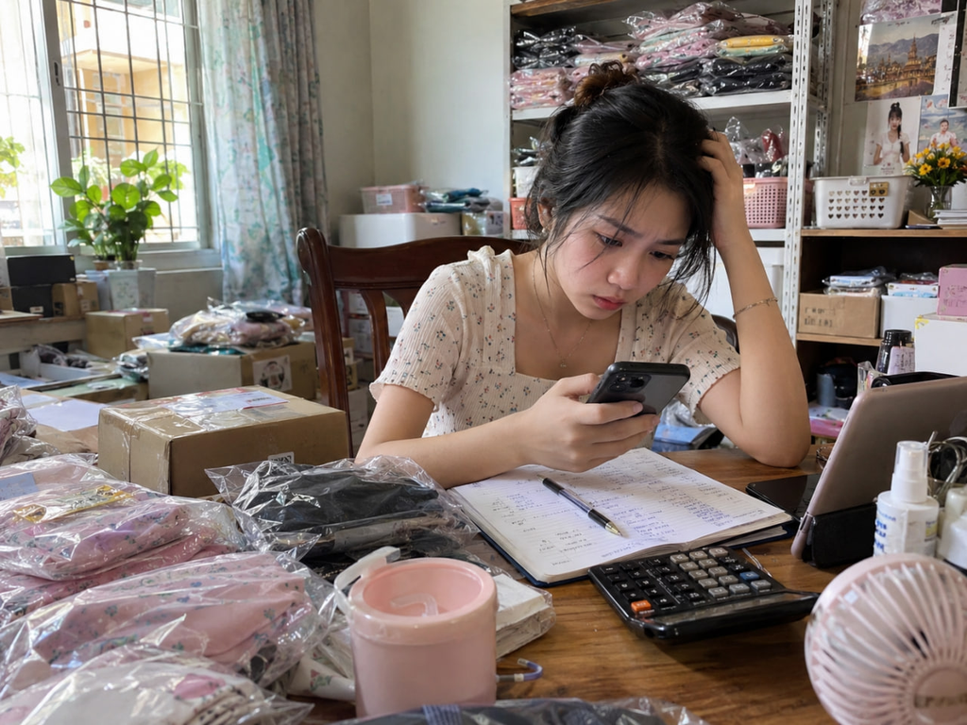

Thousands of online businesses. Millions of social media users. One seller doing everything.
21,088
Registered online operators
21.0 M
Social Media User Identities
But who manages the chats, orders, payments, and profit?
2
Into the AI ocean 2026
Notes:
Problem: chat-led sellers manage order details, payment evidence, and expenses across disconnected surfaces. The deck frames operational fragmentation without inventing a quantified pain frequency.

Slide 3



Pain Points
Order & Payment Friction
Financial Management Friction
❌ Manual Order Collection
❌ Payment Verification Stress
❌ Scattered Sales Records
❌ Unclear Daily Profit
❌ Untracked Business Expenses
❌ Difficult Outstanding Balance Tracking
3
Into the AI ocean 2026
Notes:
Who hurts: the initial beachhead is independent Facebook and TikTok sellers, especially shops where sales and operations are managed by a small team.

Slide 4

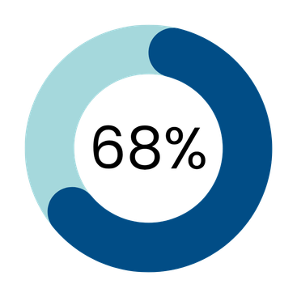
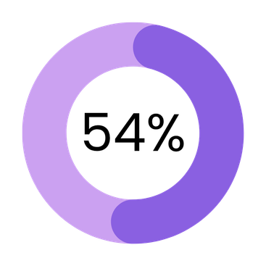
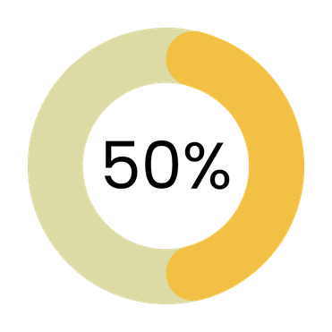
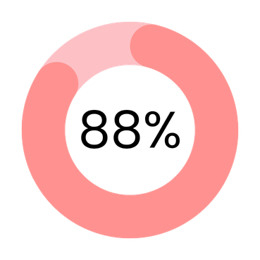
Who hurts ?
Target User -> Online Sellers
We asked 50 online shoppers about their experience
Had to resend payment screenshots
(27 out of 50)
Experienced delayed order confirmation
(34 out of 50)
Had to repeat their order details
(25 out of 50)
Preferred faster, clearer order updates
(44 out of 50)
4
Into the AI ocean 2026

Slide 5

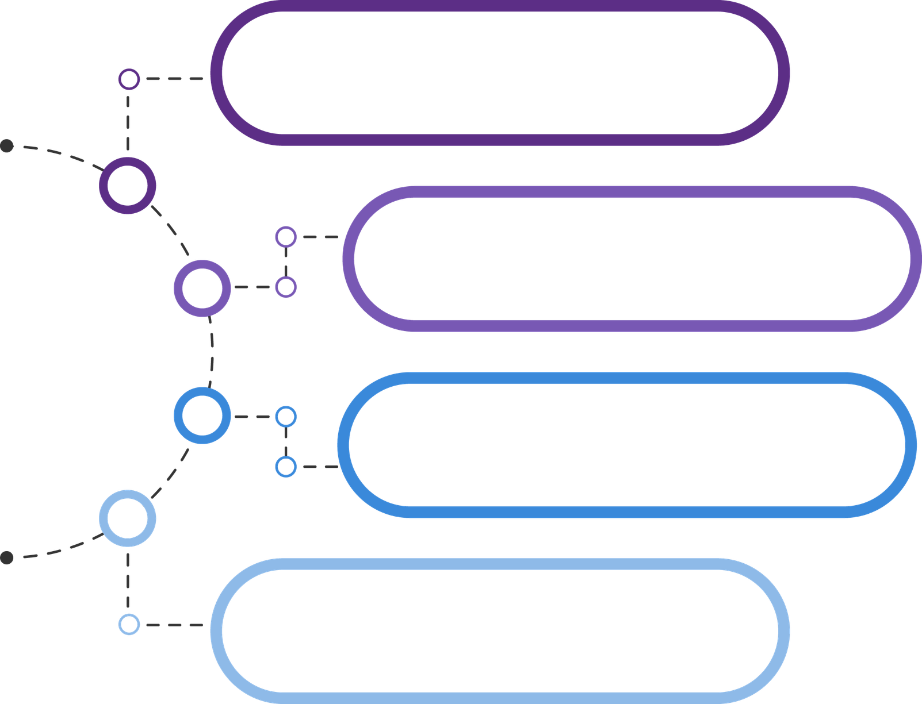




Our Solution
Chat to Order
Screenshot to Order Match
Smart Message Capture
Connected Business
Intelligence
5
Into the AI ocean 2026

Slide 6
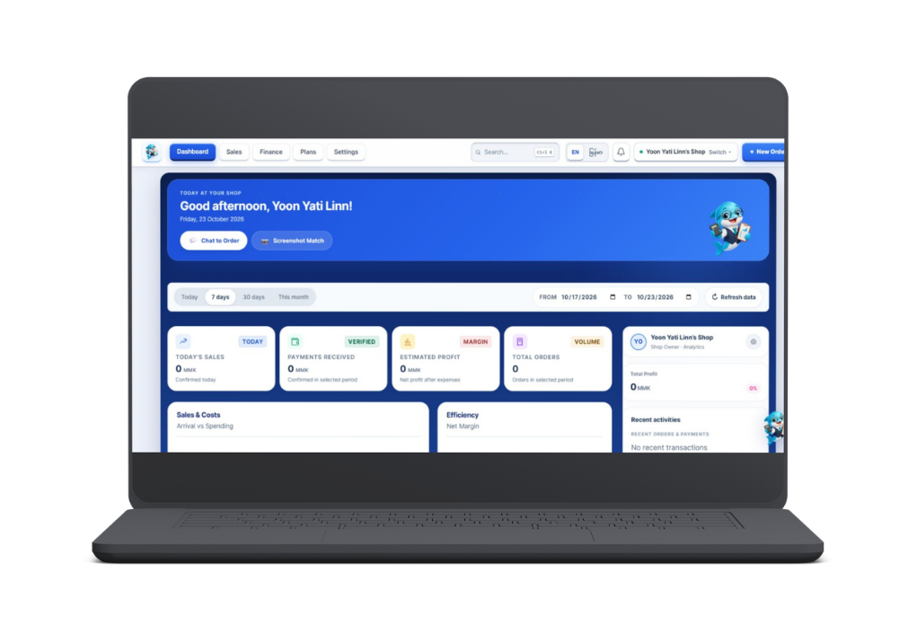
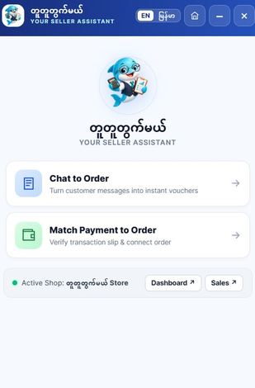
How it works
i
6
Into the AI ocean 2026

Slide 7




How AI Transforms Online Selling
1. Messy Inputs
2. AI Understands
3. Faster Actions
Language + vision models turn messy inputs into structured information.
Chats, screenshots, and orders are disconnected.
Editable orders, suggested payment matches, and clearer financial records.
7
Into the AI ocean 2026

Slide 8
Market Opportunities
TAM
21,088+
Registered Myanmar Online Operators
SAM
6000
Illustrative assumption
SOM
300
Illustrative first-year goal
8
Into the AI ocean 2026

Slide 9
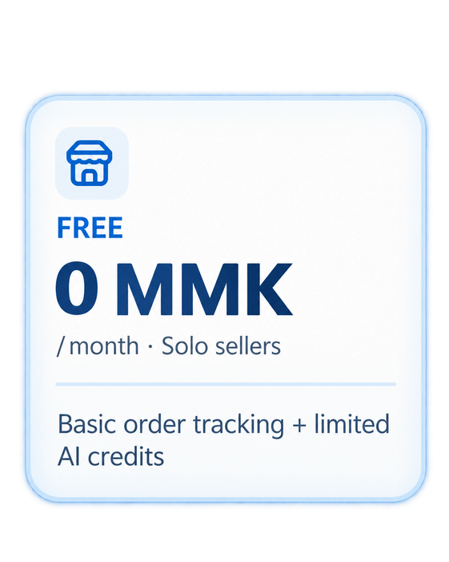
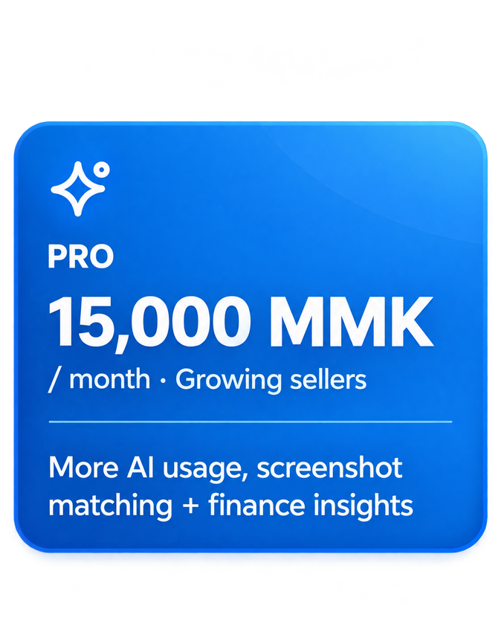
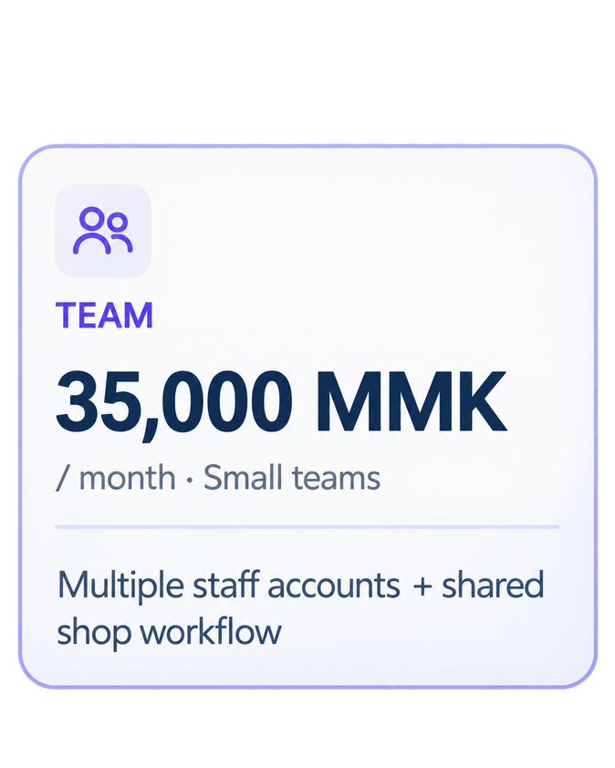
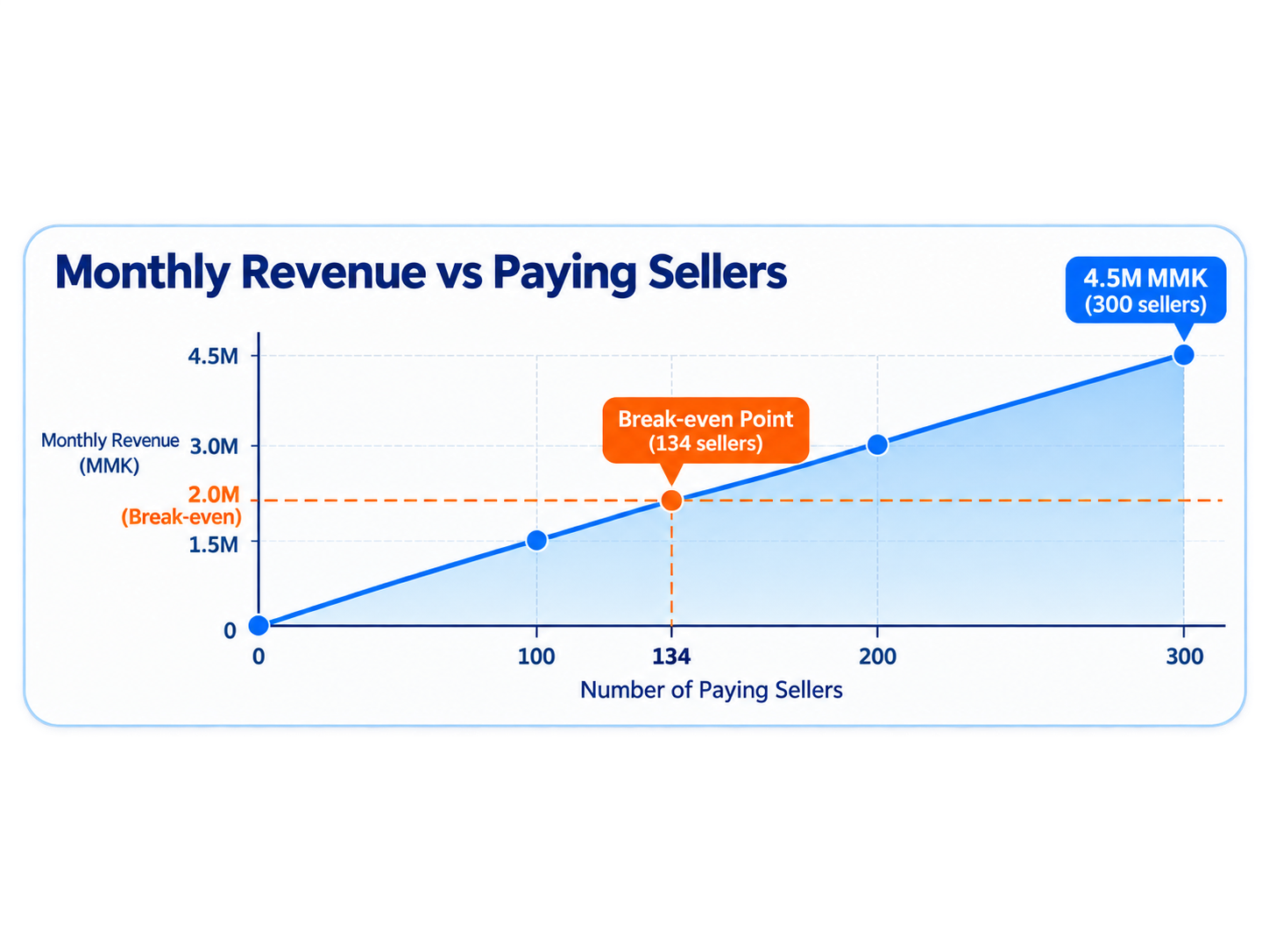


Business Model
Freemium SaaS for Myanmar Online Sellers
Annual Revenue
54M
MMK
Break-even Point
134
Sellers
9
Into the AI ocean 2026

Slide 10






From an Idea to a Working Product Foundation
Built the
merchant website and AI assistant.
Automated order forms and calculations.
Created two AI-powered workflows.
Defined key product validation priorities.
10
Into the AI ocean 2026

Slide 11








WHY CHOOSE US
Built
AI-Powered
Design for Myanmar sellers
Chat into structured orders
Connected
Seller-First
Order, payments, and profit
Practical tools with seller control
11
Into the AI ocean 2026

Slide 12


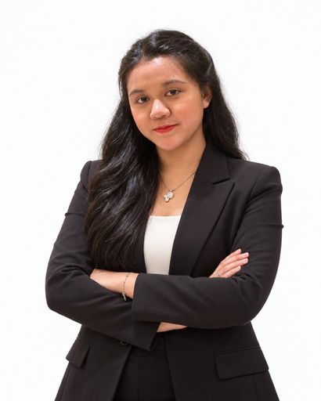
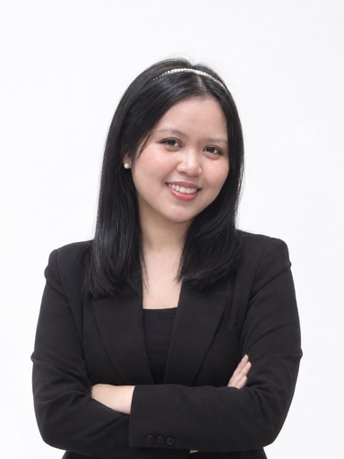
MEET OUR TEAM
You Dream of Growing Your Business. We Build the AI to Grow With You
Yoon Yati Linn
Myint Mo Phoo
Myat Hmue Hay Thi
Kyawt Swe Zin Thwin
Full Stack Developer
UX Designer
Product Owner (PO)
Project Manager
Experience
Experience
Experience
Experience
  Finalist Nominee for DEEP 2026
  Second Prize Winner at UIT Innovative Hackathon
  Developer of KuuNyi-AI (Order Management for SME Online Shops)
  Academic programming projects
  Third Prize at the 100th Engineering festival hackathon 2024
  one of the Top 3 finalist in NUS CVWO project
  Academic programming projects
  Third Prize at YTU HACKATOM 2025
  Developer of movie forum website at CVWO
  Academic programming projects
  Third Prize at YTU HACKATOM 2025
  Project Manager of Wear Cycle
12
Into the AI ocean 2026

Slide 13



Thank you
See you on the Final Day !
13
Into the AI ocean 2026

